Slide 1
Status of Mantid at the ILL
M. Gonzalez, P. Mutti, V. Reimund, A. Soininen, G. Vardanyan

Slide 2
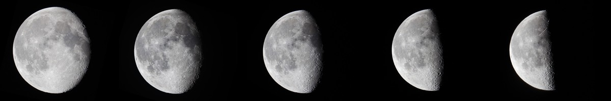
Development Status
TOF
BS
PD
REFL
SANS

Slide 3
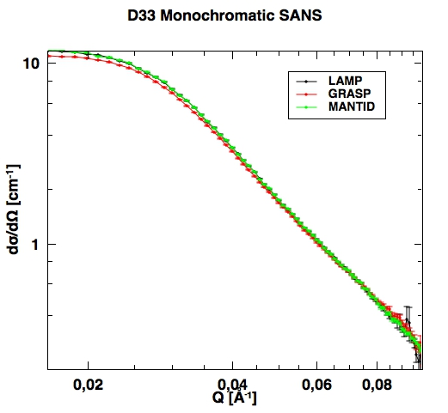
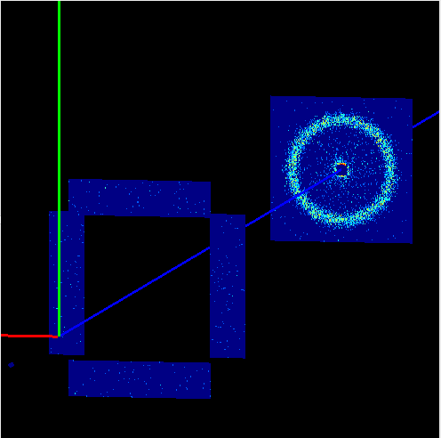
SANS
D11
Monochromatic
D22
Monochromatic
Horizontal offset
D33
Monochromatic
Linear and variable TOF
Front detector panels
Good match with LAMP, some difference with GRASP.

Slide 4
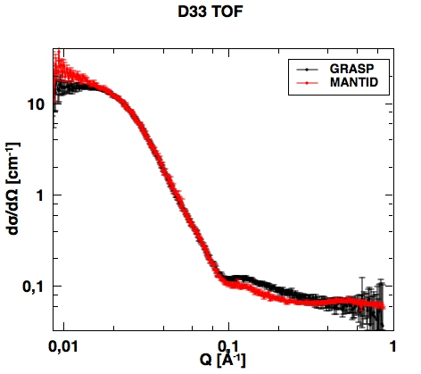
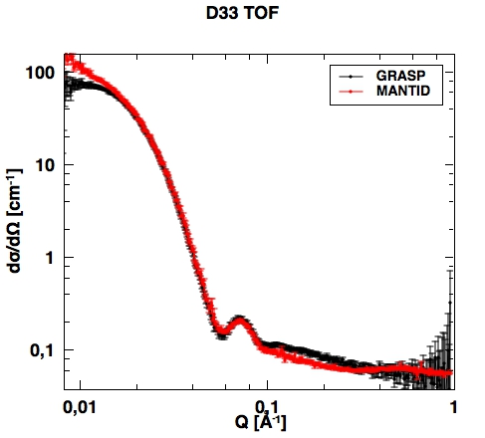
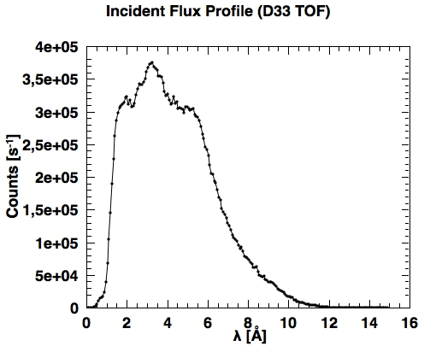
TOF SANS I
Good agreement at medium Q, some divergence at low and high Q.
Averaging scheme
Weighting scheme
Wavelength range

Slide 5
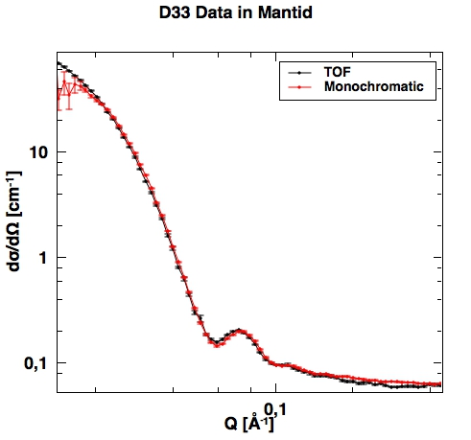
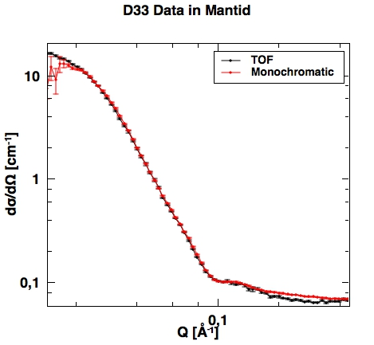
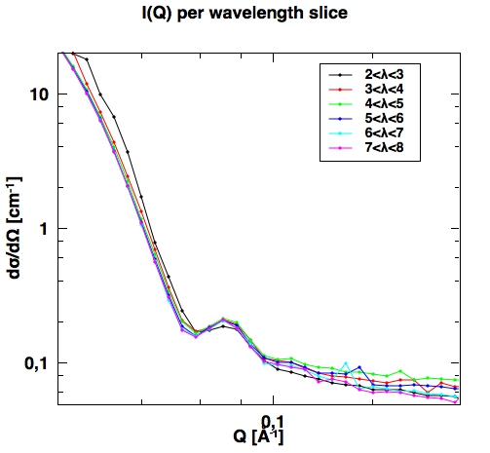
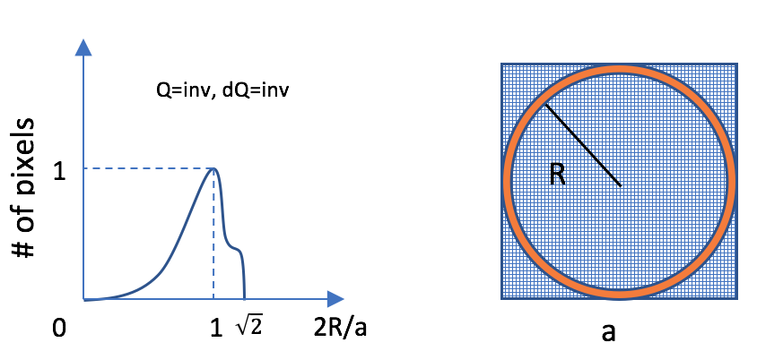
TOF SANS II
Q1DWeighted
2 step averaging
No weighting
Limited wavelength range

Slide 6
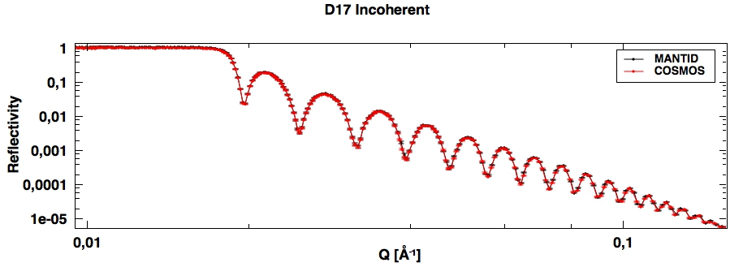
Reflectometry
D17 and FIGARO
Coherent and incoherent
Polarization analysis
Data reduction
Resolution
Stitching
Good match with COSMOS for D17 in all modes
Couple of particular scenarios for Figaro are under investigation
Auto processing algorithm to reduce an entire row of a COSMOS table

Slide 7
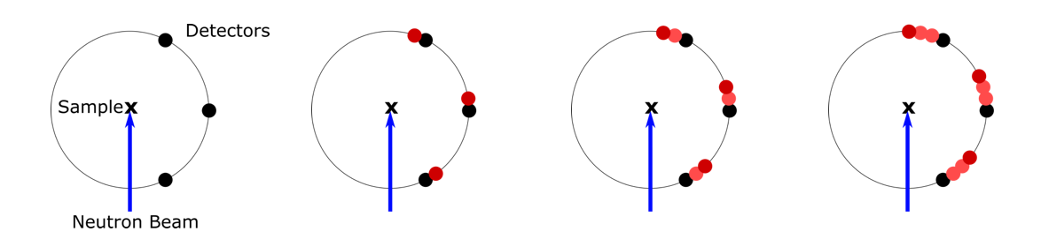
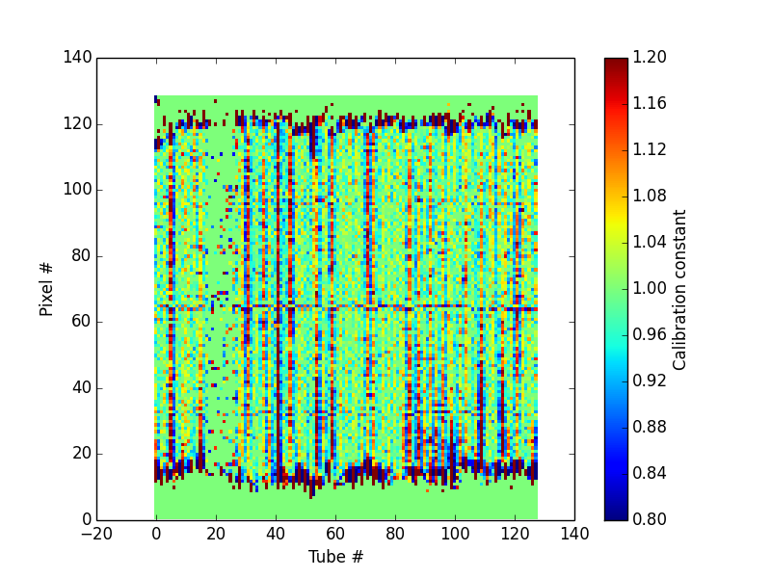
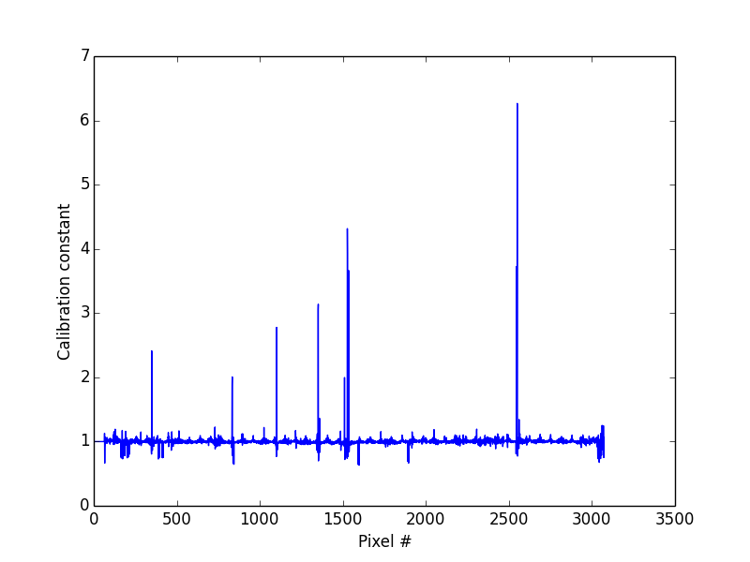
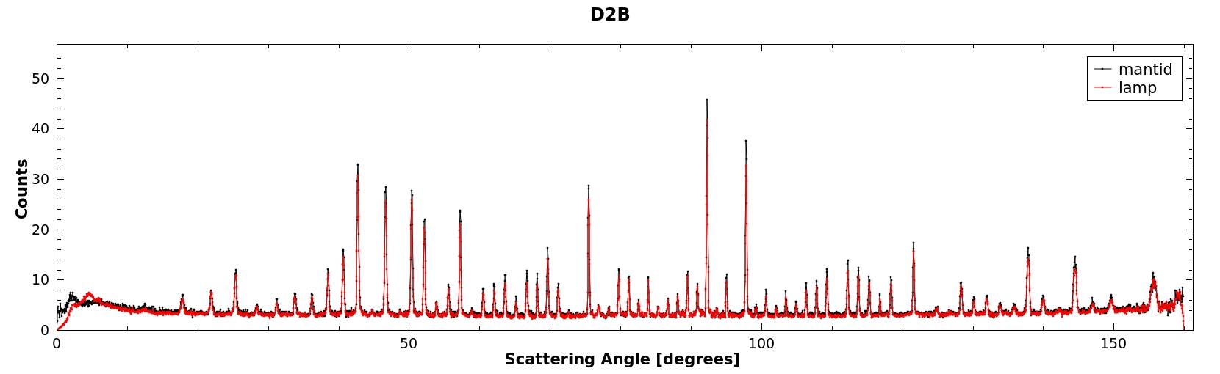
Powder Diffraction
D20, D2B - detector scans
Detector efficiencies using the vanadium scans

Slide 8
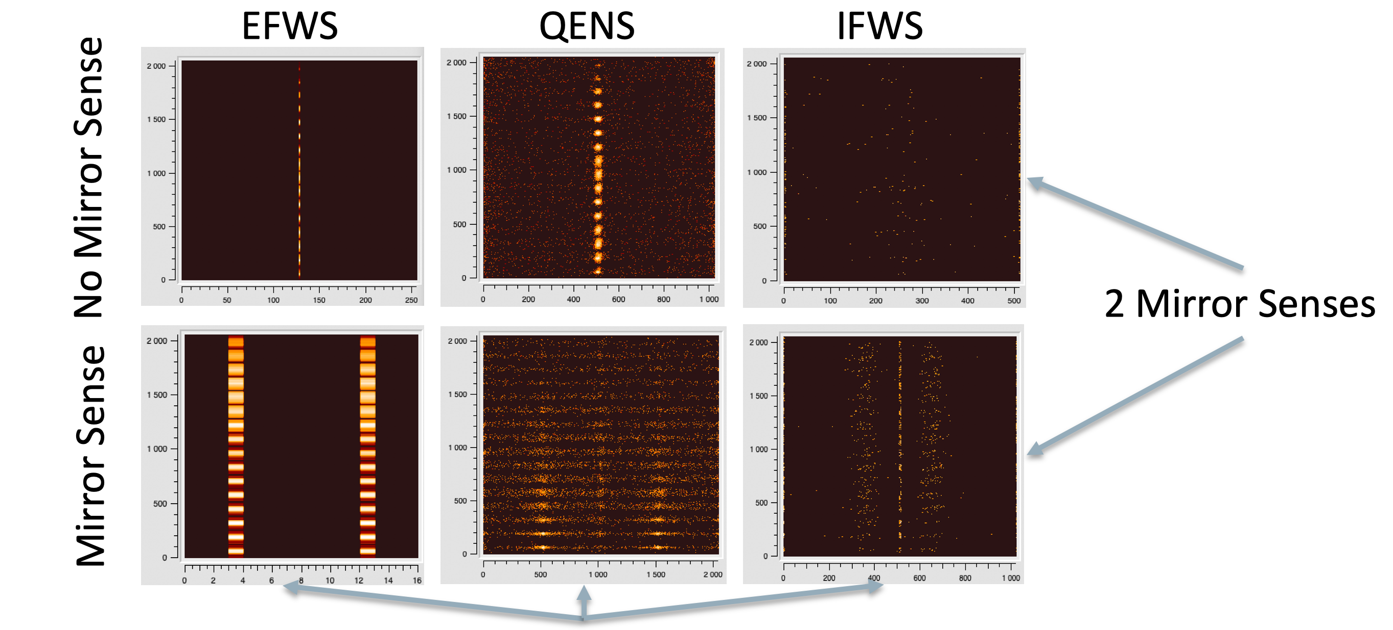
Backscattering
IN16B – doppler drive
BATS mode (TOF)
Reduction to be implemented
Diffraction detectors
Reduction to be implemented
Acquisition Modes

Slide 9
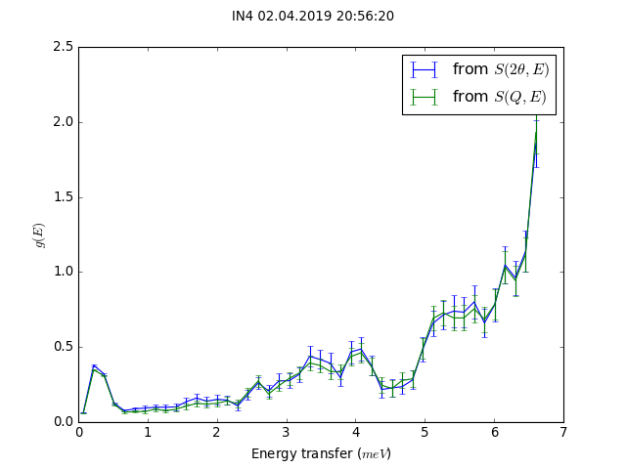
TOF Spectroscopy
SofQWNormalisedPolygon
was overestimating 2-theta widths of pixels causing artificial smoothing of the data, more prominent for detectors with large pixels
Standard plotting tool is provided.
When we share code, we share also the bugs!

Slide 10

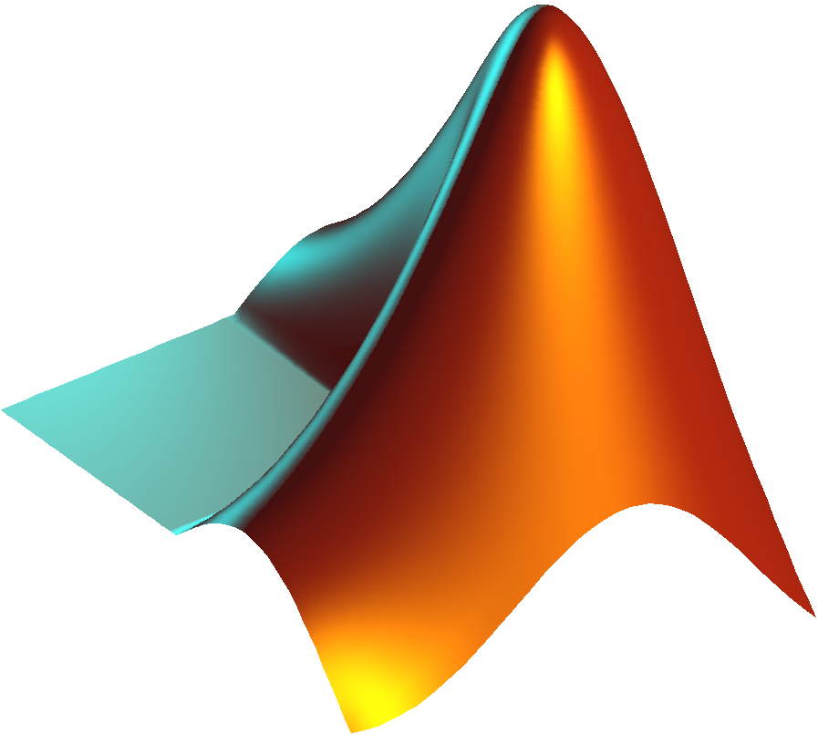


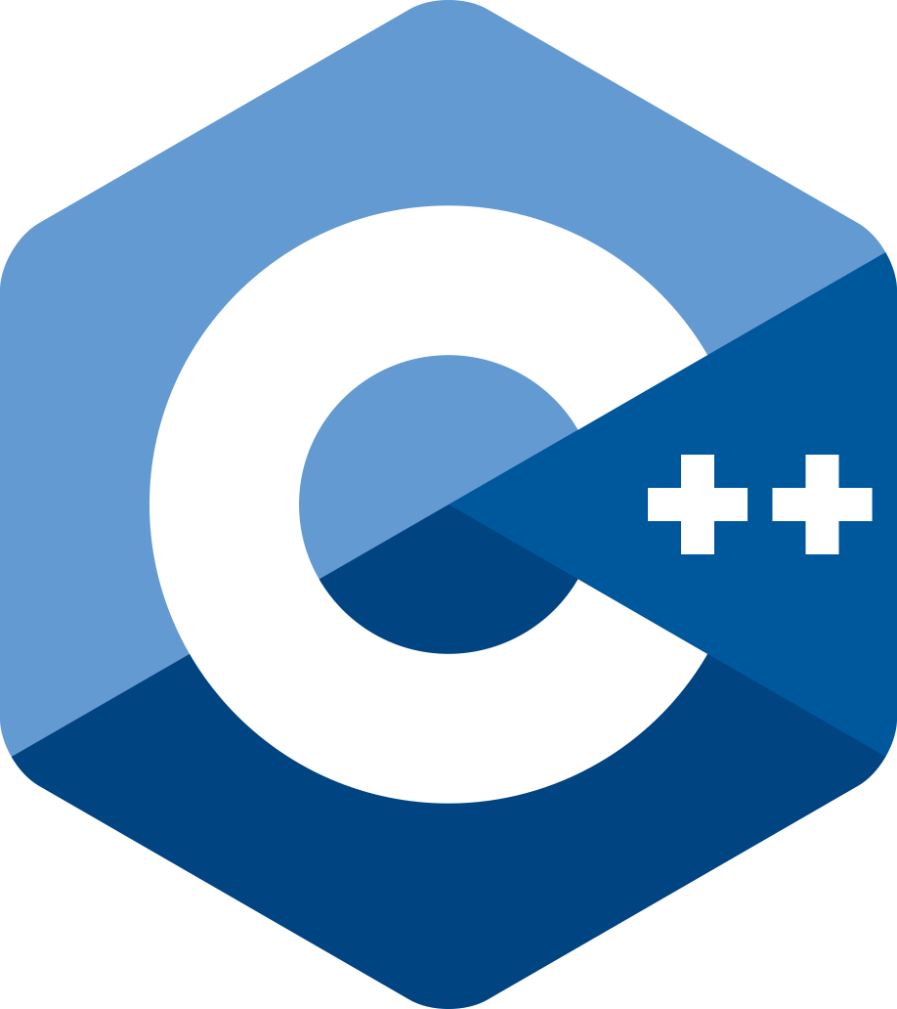

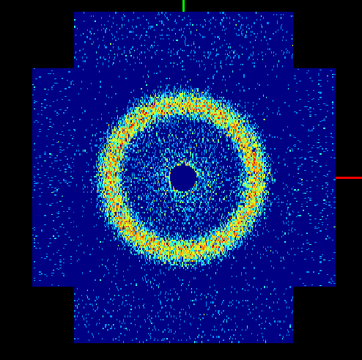



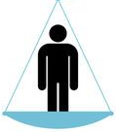




8 Reasons to move to Mantid
 | Before | After
Main language(s)
File format
Geometry | Point detectors
Version control
Automatic builds
Automatic tests |  | Unit, system, performance
Development team
Facility
ASCII
∅
∅
∅

Slide 11
How does Mantid compare with previous tools ?
Scriptability | + | Great flexibility thanks to python simple API.
Plotting | ~ | Workbench should offer nicer plots.
GUI | ~ | Do not yet have technique specific reduction GUIs.
Correctness | ~ | Can be more accurate with geometric corrections. Needs to be in use for continuous validation and improvements.
Performance | ~ | Can be faster or slower. Equivalent for I/O dominated reductions.
Stability | ~ | Hard to crash mantid when running in batch mode python. Somewhat easier when running the MantidPlot.
Reproducibility | + | System tests ensure the reproducibility.
Learning curve | + | Easier to get into if you are familiar with python.

Slide 12
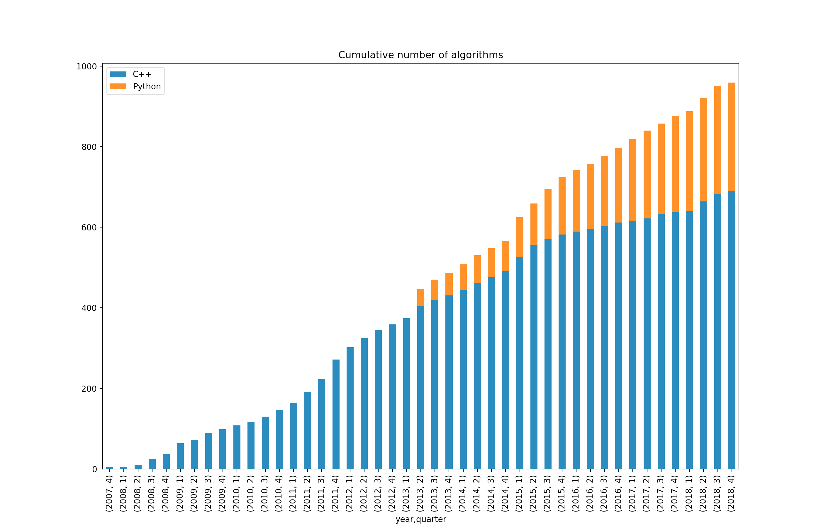
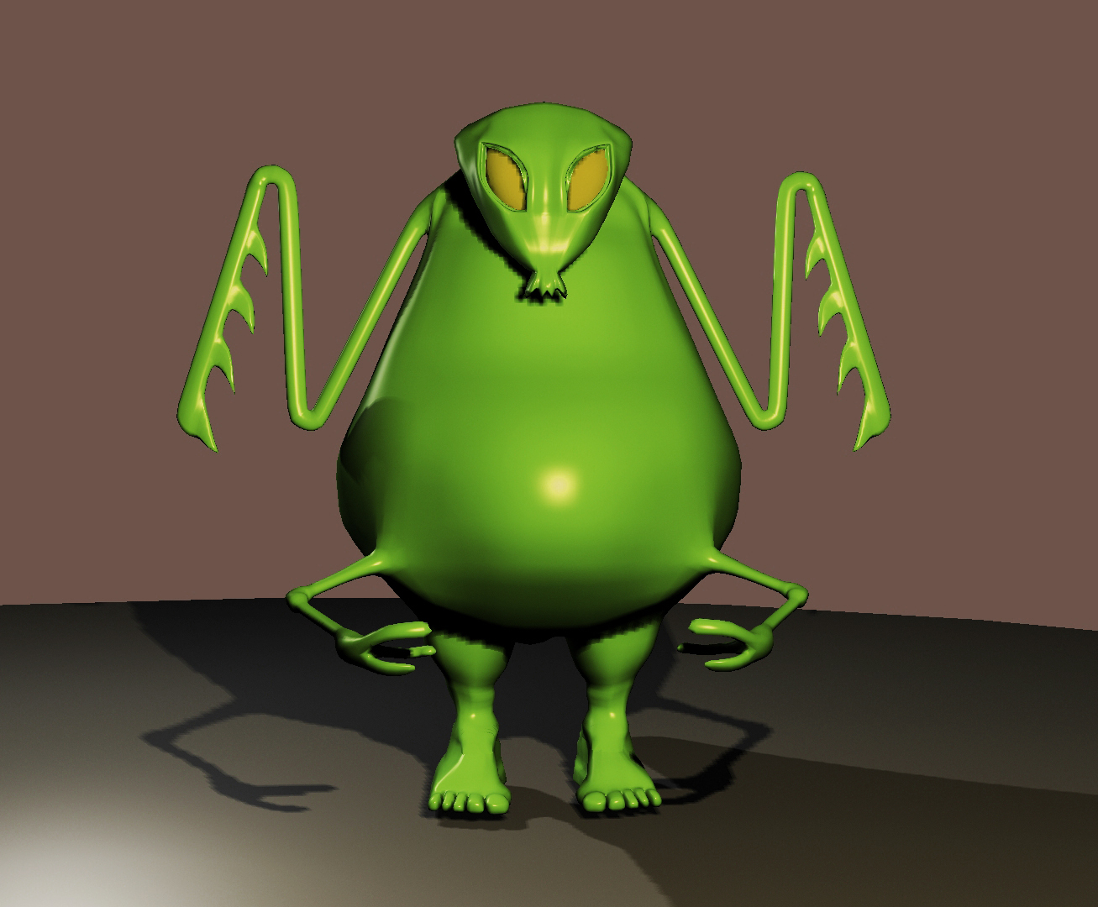
Mantid is growing
Figure by Simon
But not unmanageably!
Constant effort to consolidate and reuse existing algorithms, share workflows where possible.

Slide 13
User feedback summary
Generally positive
Scriptability is appreciated
Plotting tools could be improved
Scientific validation could be more rigorous
Occasional instabilities in MantidPlot GUI
Absence of some common tools existing in LAMP
Inconveniencies for non-TOF data, especially scans
Lacking in post-reduction automation (fitting, analysis)

Slide 14
Phase II
Reduction algorithms for another dozen of instruments
Continuous development and support for the techniques currently implemented
Auto processing algorithms campagne
GUI and live data reduction
Event mode data reduction for certain instruments
New staff to be recruited
Project to launch later this year

Slide 15
Thank you.

